Slide 1

Decision Trees Project
- by
Sreenija Dharma
Bal Thirupathi Guddati Sandeep Chanda

Slide 2
context
Objective
Introduction
MDA and MDG
Confusion Matrix
Recommendations
Decision tree model

Slide 3

objective
Aims to demonstrate a food manufacturing company can leverage customer data and decision tree modeling to develop a targeted marketing strategy for promoting their oatmeal products. By analyzing customer demographics, lifestyle factors, and breakfast preferences, identify potential oatmeal consumers and tailor marketing efforts to resonate with specific audience.
This data-driven approach can significantly increase the effectiveness of marketing campaigns and ultimately boost oatmeal sales.

Slide 4
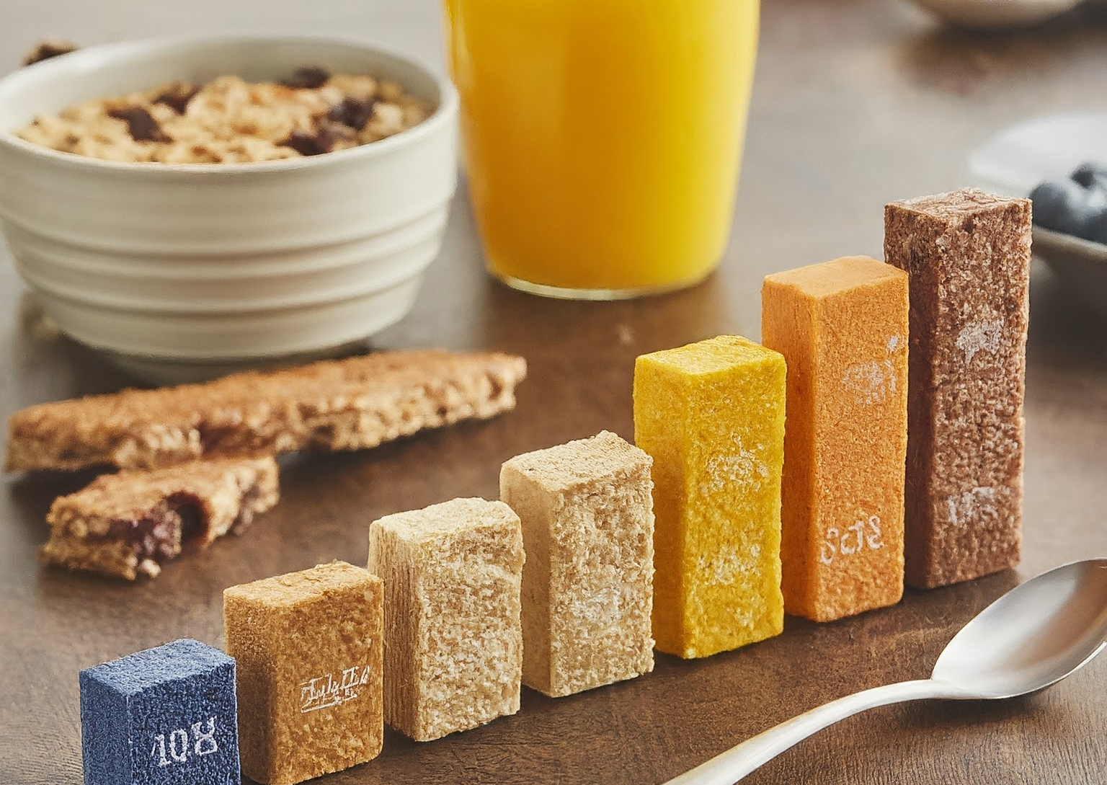
Introduction
Data set of 880 individuals with demographic and lifestyle factors such as age, gender, marital status, exercise habits and breakfast preferences.
Breakfast preferences: cereal, oatmeal, oatmeal, cereal bars
By analyzing this data, we identified the factors that most influence people's preference oatmeal for breakfast.

Slide 5
R CODE TO CALCULATE THE MDA AND MDG
#attach the data file to Rstudio
attach(Cerealdata_2024)
#Install Packages
install.packages("rpart.plot")
install.packages("randomForest")#
#Load necessary libraries
library(randomForest)
library(rpart.plot)
# Convert categorical variables to factors
Cerealdata_2024$age <- as.factor(Cerealdata_2024$age)
Cerealdata_2024$gender <- as.factor(Cerealdata_2024$gender)
Cerealdata_2024$marital <- as.factor(Cerealdata_2024$marital)
Cerealdata_2024$exercise <- as.factor(Cerealdata_2024$exercise)
Cerealdata_2024$breakfast <- as.factor(Cerealdata_2024$breakfast)

Slide 6
R CODE FOR CREATING TRAINING AND VALIDATION SETS
# create random forest model and evaluate prediction accuracy
# Creating training and validation sets
# Split data into training and validation sets
#Training Set: Validation Set =70:30 (random)
set.seed(200)
train_index <- sample(nrow(Cerealdata_2024), 0.7 * nrow(Cerealdata_2024), replace = FALSE)
trainset <- Cerealdata_2024[train_index,]
validset <- Cerealdata_2024[-train_index,]

Slide 7
#Create a random forest model
Model <- randomForest(breakfast ~ . , data = trainset, importance = TRUE)
# Analysis of predictors importance
print("Mean Decrease Accuracy:")
importance_acc <- importance(Model, type = 1)
print(importance_acc)
print("Mean Decrease Gini:")
importance_gini <- importance(Model, type = 2)
print(importance_gini) #to check important variables
importance(Model)
varImpPlot(Model)

Slide 8
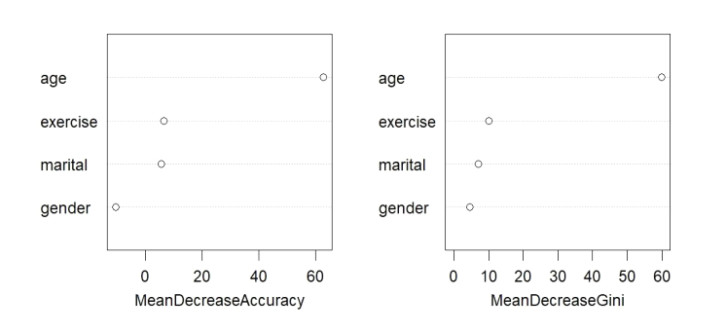
MDA and MDG
Age has the highest Mean Decrease Accuracy (62.75) and Mean Decrease Gini (59.89), indicating a strong influence on breakfast preference. This suggests focusing marketing efforts on specific age groups.
While exercise habits (MDA: 6.60, MDG: 10.02) and marital status (MDA: 5.49, MDG: 6.97) show some influence, they are significantly less important than age. Gender has the least impact (MDA: -10.41, MDG: 4.46) and can be disregarded for initial targeting.

Slide 9
R CODE FOR PREDICTING ON TRAINING AND VALIDATION SETS
# Predicting on training set
predtrain <- predict(Model, trainset, type = "class")
# Checking classification accuracy on training Set
train_conf_matrix <- table(predtrain, trainset$breakfast)
print("Confusion Matrix for Training Set:")
print(train_conf_matrix)
# Predicting on validation set
predvalid <- predict(Model, validset, type = "class")

Slide 10
# Checking classification accuracy on validation set
valid_conf_matrix <- table(predvalid, validset$breakfast)
print("Confusion Matrix for Validation Set:")
print(valid_conf_matrix)
# Calculate accuracy on validation set
accuracy <- mean(predvalid == validset$breakfast)
print(paste("Accuracy on Validation Set:", accuracy))

Slide 11
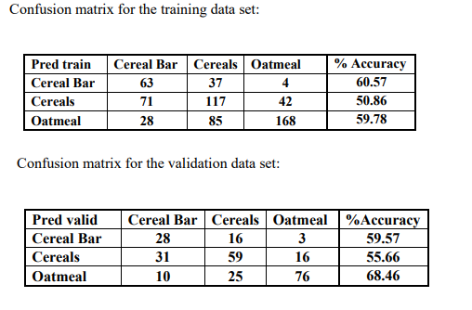
Confusion Matrix
Oatmeal classification shows the most significant improvement (8.68%) on unseen data, suggesting the model generalizes better for oatmeal preference.
Overall accuracy is moderate (61.74%) with some variation, but the slightly higher validation accuracy indicates the model may not be severely overfitting.

Slide 12
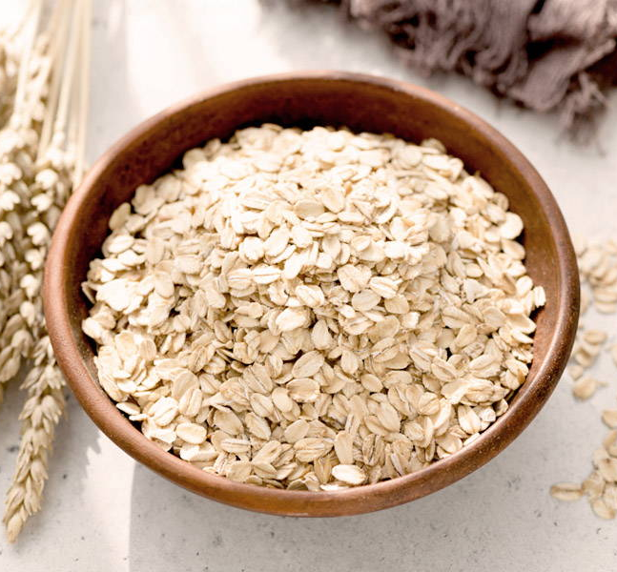
Recommendations
From the analysis, we observed that age is a significant factor in predicting breakfast preferences, so the company should customize ads for different age groups and notify them how important oatmeal is for a healthy lifestyle, which helps the company attract a larger audience and increase their sales.
Highlight oatmeal's health benefits, especially for active people.
Educate people about oatmeal's benefits and versatility. They could show different ways you can make oatmeal taste good and how you can eat it for breakfast in lots of ways.
The company should produce the oatmeal products in different flavors so that they can increase sales of the products.

Slide 13
R code
#Decision tree graphic
# Train a decision tree model
tree_model <- rpart(breakfast ~ ., data = Cerealdata_2024, method = "class")
# Plot the decision tree
rpart.plot(tree_model)

Slide 14
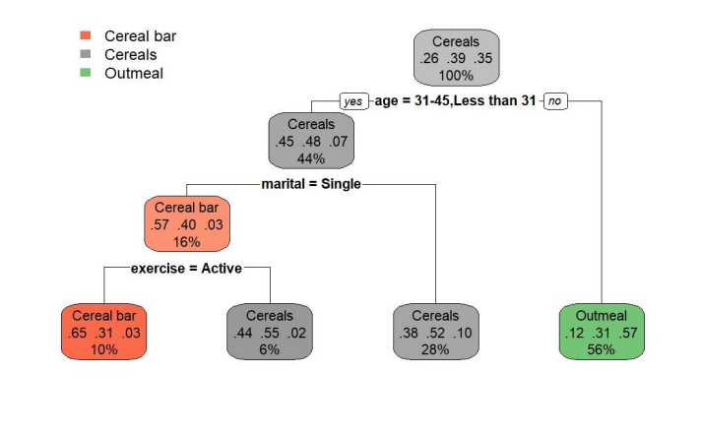
Decision tree model

Slide 15
Thank you!

